Slide 1
Quick rules
How to Fail Your Research Degree

Slide 2
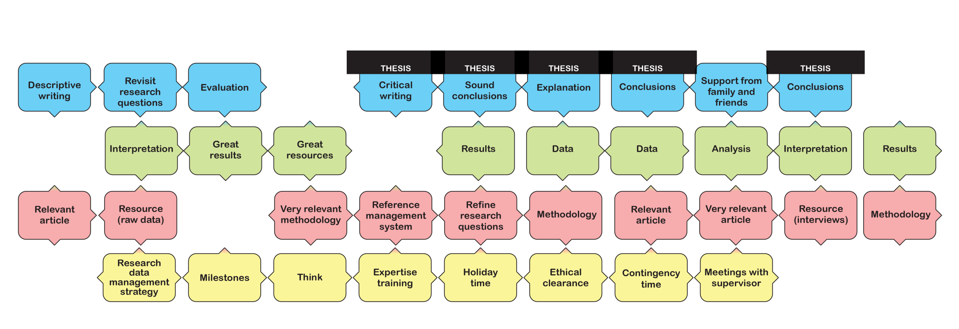
Each round is played horizontally
Four rounds, starting with PLAN, ending with WRITE-UP

Slide 3
Aim of the game = long line of Thesis tiles
Only the longest line will count

Slide 4
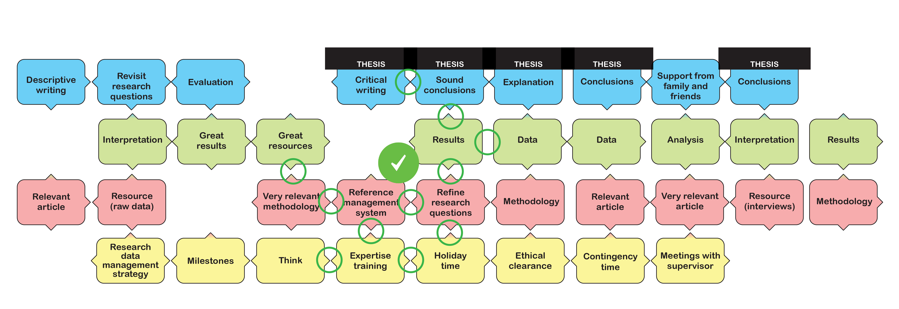
Arrows must match arrows, blank edges must match blank edges

Slide 5
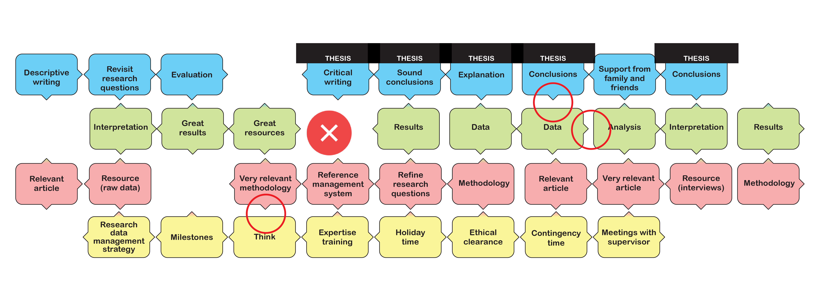
Arrows must match arrows, blank edges must match blank edges

Slide 6
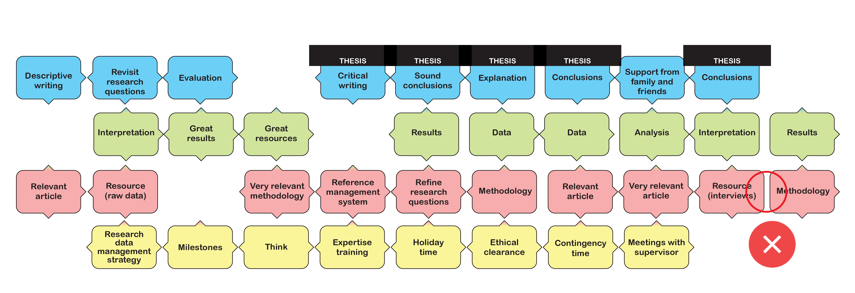
Every tile must be connected by at least one arrow

Slide 7
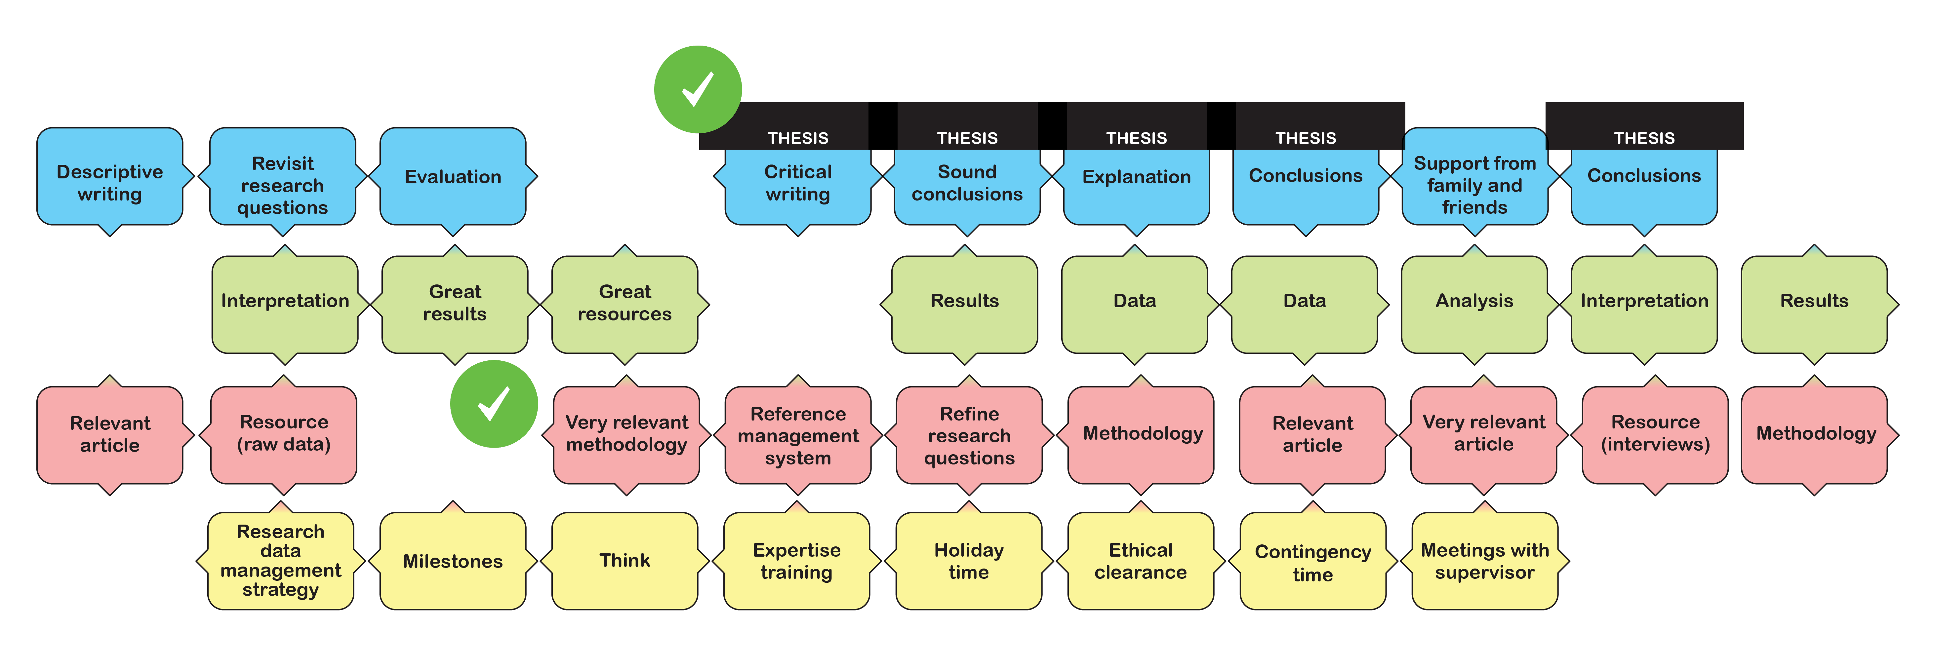
Gaps are fine, bridging is fine (as long as connected by at least one arrow)

Slide 8
If you can play, you MUST play
Even if the card is bad, if you can play you must. You may only discard a card if there really is nowhere you can play it.
If there are spaces left in your research framework, keep drawing cards until you find one you can play legally.

